Slide 1
Different Approaches towards Image Super Resolution
Final Project Presentation - Dhruvil Parikh

Slide 2
Introduction
Image Super Resolution means to transform an image from low resolution space to a high resolution space.
It increases pixel density and overall gives more information on the scene that is to be processed.
Need arises as the setup for high resolution imaging is expensive and might not always be feasible owing to the inherent limitations of the sensors.
Low Resolution Images saves storage space, requires low computation power and older systems can still be employed without having to replace them.
Most important applications are in zooming to the specific area of interest in image wherein high resolution is essential such as forensic analysis, satellite imaging and surveillance.

Slide 3
Brief Description
The aim of this project is to go through the literature and study the networks that came with time to perform Image Super Resolution, to implement them and generate custom results to observe the scale to which a particular network can upscale an image.
The following networks are considered:
SRCNN (Super Resolution using Convolutional Neural Networks)
EDSR (Enhanced Deep Residual Networks for Single Image Super-Resolution)
ESPCN (Efficient Sub-Pixel Convolutional Neural Network)
FSRCNN (Fast SRCNN)
LapSRN (Deep Laplacian Pyramid Image Super Resolution Networks)

Slide 4
Related Work
Related works can be divided into the following categories:
Traditional Approaches
CNN Based Approaches
Laplacian Pyramid Based Approaches
GAN Based Approaches

Slide 5
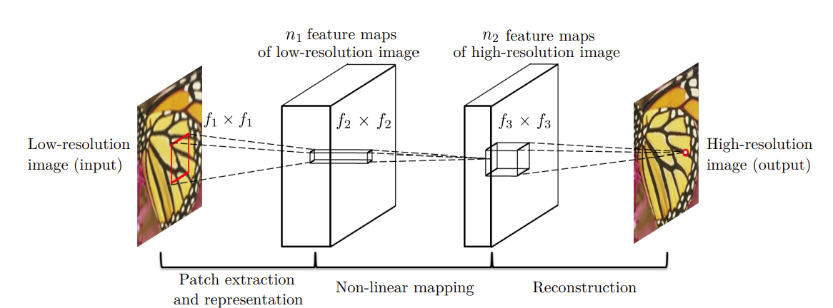
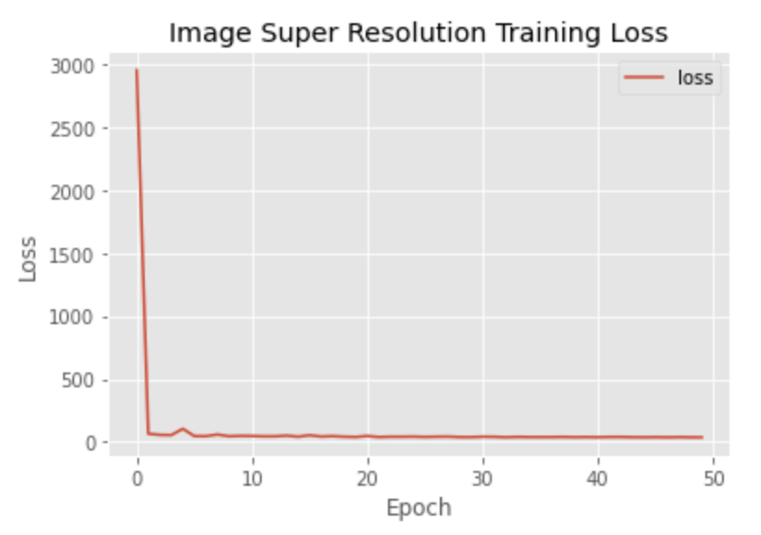
SRCNN Implementation
Dataset Preparation
Architecture
Working

Slide 6
Upscaling Efficiency as per my Experimentation with different architectures
SRCNN: 2x
FSRCNN: 3x
EDSR: 4x
ESPCN: 4x
LapSRN: 8x

Slide 7
Results

Slide 8
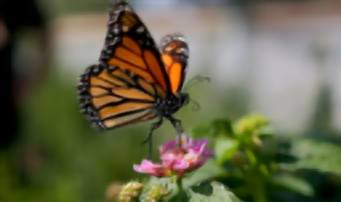



(Left)
FSRCNN
(Right)
ESPCN
(Left)
EDSR
(Right)
SRCNN

Slide 9


(Top-Left)
Original
(Bottom-Right)
LapSRN

Slide 10

Demonstration
(Real-Time Image Super Resolution)
Original Video Clip
ESPCN 4x Resolution Video

Slide 11
Thank You!!

